Slide 1

UDD - Universidad del Desarrollo_MDS - Master in Data Science
PRODUCT RECOMMENDER
CHATBOT
Students
Rovai, Marcelo_ Sacasa, Manuel
Professors
Reinoso, Pablo_ Seguel, Rodrigo
May, 2019

Slide 2
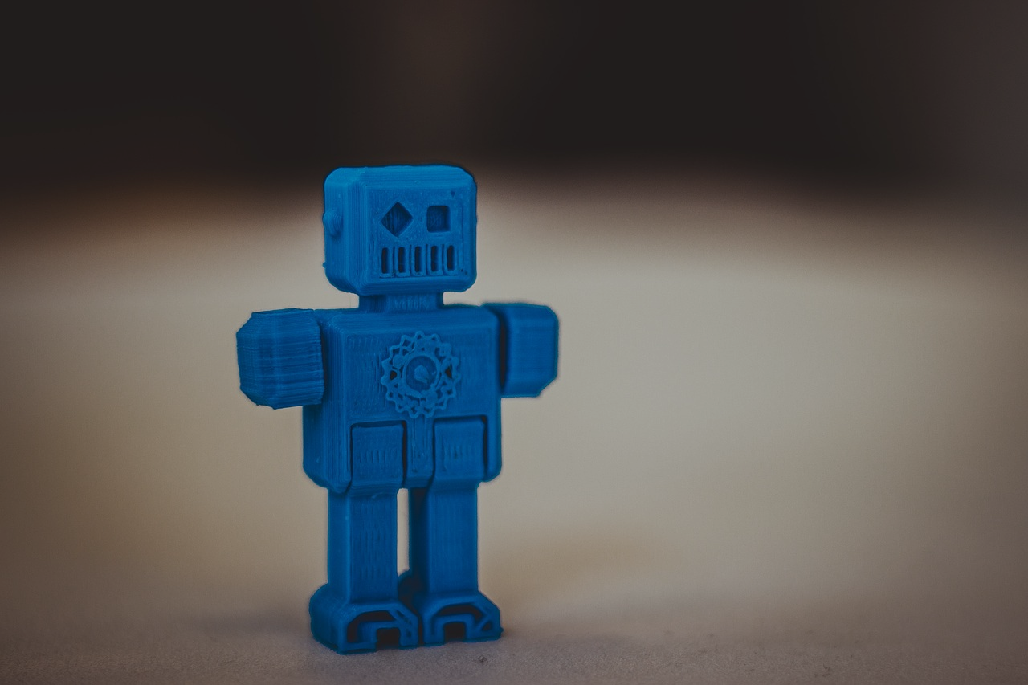
PARTS & PIECES
Steps for the developing, designing and building a recommender chatbot
1_DATA SET AND MODEL
Data engineering and filtering to built a Bot Dataframe with users and recommendations
2_BOT DESIGN
Architecture, personality and Q&A tree for different recommendations
3_BUIDING A BOT
Cloud tools, intents, entities and dialogues

Slide 3

COLLABORATIVE
FILTERING
As stated by Yifan et al, a common task of recommender systems is to improve customer experience through personalized recommendations based on prior implicit feedback. These systems passively track different sorts of user behavior, such as purchase history, watching habits and browsing activity, in order to model user preferences. Unlike the much more extensively researched explicit feedback, we do not have any direct input from the users regarding their preferences. In particular, we lack substantial evidence on which products consumer dislike.
Collaborative filtering refers to the process of identifying patterns among the objects in a dataset in order to make a decision about a new object. In the context of recommendation engines, we use collaborative filtering to provide recommendations by looking at similar users in the dataset.
The assumption here is that if two people have similar ratings for a particular set of movies or series, then their choices in a set of new unknown movies would be similar too. By identifying patterns in those common content, we make predictions about new movies or series.
Collaborative filtering is typically used when we have huge datasets. These methods can be used for various verticals like finance, online shopping, marketing, customer studies, and so on.

Slide 4


RECOMMENDER APPROACH
User 0001
Film_001 Film_002 Film_003 Film_004
User 0002
Film_004 Film_001 Film_002 Film_003
Similar user without a film. Recommendation film/serie to complete perfect match
Similar user without a film. Recommendation film/serie to complete perfect match

Slide 5

DATA SET
•All data are from Chile
•6 months of data, collected from 09/01/2018 to 03/10/2029
•187K observations:
•Series 123,016
•Movies 58,845
•Live TV 5,402
•41,442 unique customers
•12,845 different titles on dataset (id_grupo)
•Each Serie episode has a unique id_grupo
•4,373 unique movie/series titles
•There are 2 types of operation: Subscription (~94%) and Rent
•Majority of streaming happen in mobile phones, followed by TV and web browsers
•30% of "MAX_VIS", that is the maximum time spent on streaming are “null”
•5,016 ID_CLIENTE are NULL - Make no sense customers with Null ID, should be deleted
•ID_GRUPO and ID_CLIENTE will be converted to integer to reduce memory space
•“DURACION_TOTAL” has 3,655 observations invalid. From that, 3,653 are related with “Live TV” and 2 for movies. It is OK for Live TV to have no data regarding total duration time, but not for movies. Those 2 observations are related with ID_GRUPO = 779381, that has a null total duration time and was not seen by users (o or also null time). Those data should be deleted.
•FECHA_PAIS should be converted to datatime format

Slide 6
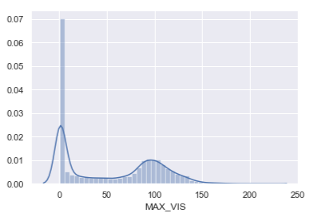
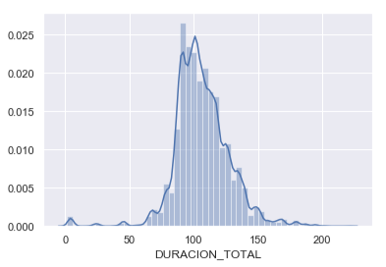
1_DATA SET CLEANING
•MAX_VIS being Null make no sense for series and movies (it is OK for Live TV), but should be kept because shows that spite that user could not "connect" (or data is wrong), he is in principle interested on that content. Null value should be converted to '1' (1 minute of view).
•MAX_VIS negative values (1 observation) must be deleted.
•DURACION_TOTAL , that is the total duration time of content must be converted to minutes format (for example: 01:20:30 converted to 80.5)
•There are 26 items, Series episodes with total duration equal to zero. We must change it to median that should be 42 minutes

Slide 7
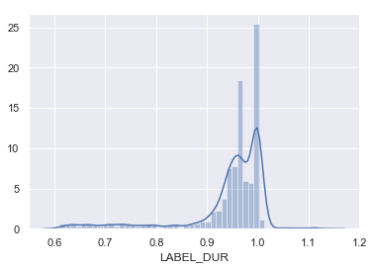
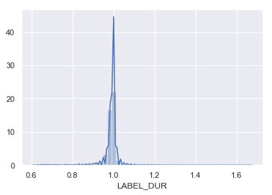
1_DATA SET CLEANING
•LABEL_REC: A new column is created with the simple (and clean) title, been series (w/0 "s2e7" for example) or movie.
•LABEL_DUR: A new column with percentage of max view over total duration is created
•Dataset is filtered for LABEL_DUR > 60% and duplicates eliminated.

Slide 8
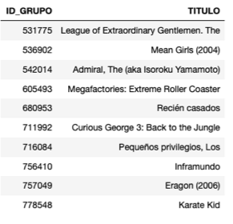
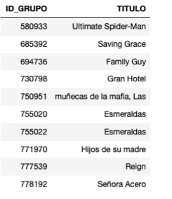
1_THE MOST SEEN
•Once we have 2 filtered and cleaned datasets, one for movies and one for series, where only content that was really saw was kept (more than 60%), it is interesting to know what were the most seen movies and series on current/past month. This answer will be important to recommend content to users that have not enough data to be used with trained model.

Slide 9

1_DATA PRE_PROCESSING
•The data to be used with Implicit Library, should be grouped in two variables, ID_CLIENT (user) and ID_GRUPO (content), having a count column created with number of times that a specific content were seen (in our case will be 1).
•Those variables must be converted to “category”
•To make sense, a recommender model based on content seen by a user must have a minimum of items seen by an individual customer in order to use it for recommendation. 4 is an empirical value based on practice. But for this project, we will keep it at “1”, because only 10% of users has a decent number of content history.

Slide 10
1_THE MOST SEEN
•Once we have 2 filtered and cleaned datasets, one for movies and one for series, where only content that was really saw was kept (more than 60%), it is interesting to know what were the most seen movies and series on current/past month. This answer will be important to recommend content to users that have not enough data to be used with trained model.

Slide 11
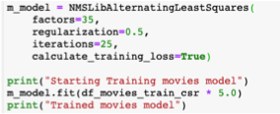
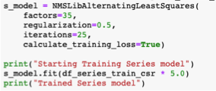
1_RUNNING THE MODEL
•The date will be split in Train (80%) and Test (20%)
•The model will be run separated, once for movies dataset and once for series dataset.
•The model from Implicit library to be used is: “NMSLibAlternatingLeastSquares”, with parameters:
• factors=35,
• regularization=0.5,
• iterations=25,
• calculate_training_loss=True
•From Train part of data, a sparse matrix is created
•The model is applied over the sparce matrix
•Alpha parameter of 5 (empiric)

Slide 12
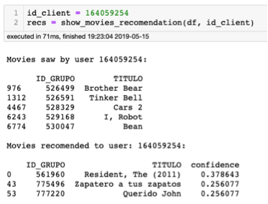
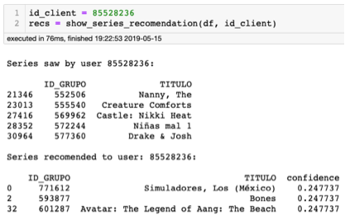
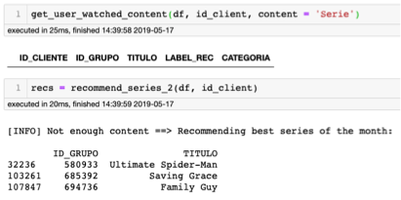
1_TESTING THE MODEL
Selecting IDs from top users
1_TESTING
THE MODEL/API
•Selecting ID from user with few content. The Model will not return a recommendation.
•When a user has very few views, for example (id_client = 151650306), with only 2 movies seen and no series, the final API should return for example the “the most seen content of the month”.

Slide 13
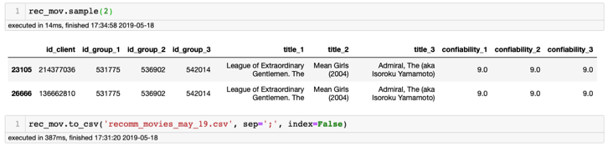
1_CREATING A RECOMMENDATION DATA BASE
•To the original list of all users will be applied the model and the 3 recommendations with its respectively data: ID_GROUP, Title and Confiability, will be saved on a CSV file (one file for movies and one file for series.
•In case of the user returned no data (few content saw by user), the monthly recommendation will be add to that specific user. An arbitrary confiability of “9” was plugged. This number is to help the easy identification of a user that was recommended with the monthly content.
month”.

Slide 14
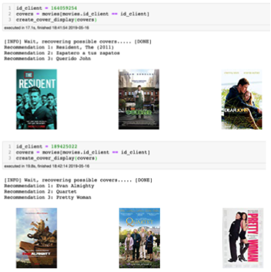
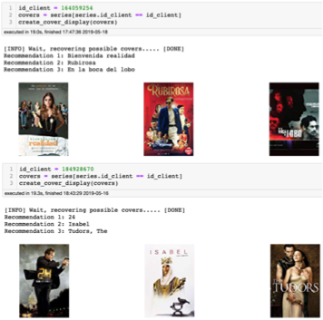
1_OPTIONAl: ART COVER RECOVERY

Slide 15


2_ARCHITECTURE
Watson Assistant
@Entities
#Intents
Dialogues
Functions
Queries per user ID
CHATBOT
DB2 (Recommendation per ID/user)
Film Database
Serie Database
Recommendation Model. Output recommendations per ID/user
Raw Data
Technically a recommendation Bot is a loop for re-training the recommendation model with new users preference. In this first exercise we disable the connection between chatbot and raw data

Slide 16

2_PERSONALITY
FORMALITY
The answer should have the same tone, formal style and grammar. For example: Tutear, usted, etc. This will profiled the bot as an expert, friend, etc.
LANGUAGE
The answer should be written in the same language of the user.
EXPRESSIONS
The style, saids and ways should be coherent with the formality tome of the dialogue. Not= a friend of 80 years, an expert of 15 years
VALUE TIME
User should have a recommendation as an answer next after a film/serie request. Not over Chat.
COHERENCE
All the personality design decisions should be in all the dialogues. No answers with “ud” and other with “tu”. Or singular and plural.

Slide 17

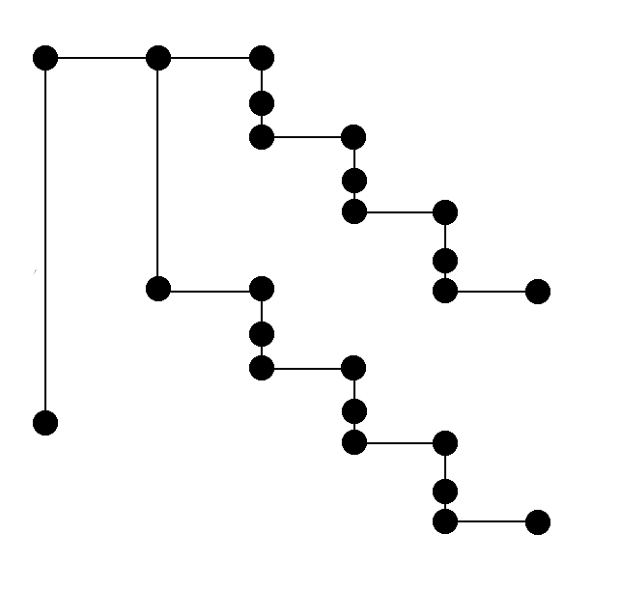
2_Q&A TREE LOGIC
Welcome
Film
Recommendation_1
Approval
Recommendation_2
Approval
Reproval
Recommendation_3
Approval
Reproval
R_1
Approval
Serie
Reproval
Exit
R_2
Approval
Reproval
R_3
Approval
Not understand
Reproval
Reproval
Exit

Slide 18
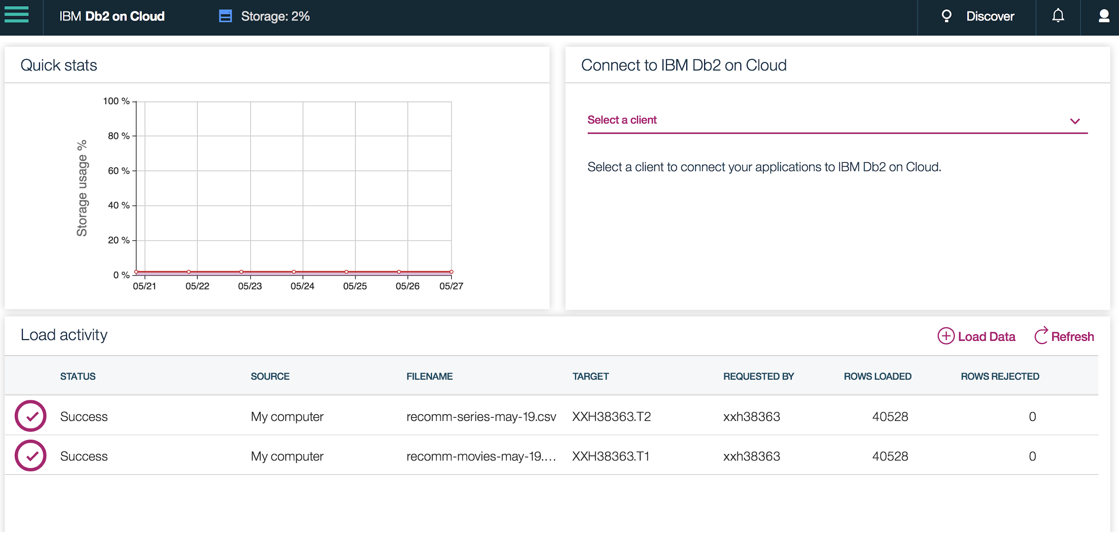
3_FILM/SERIE DATABASE

Slide 19
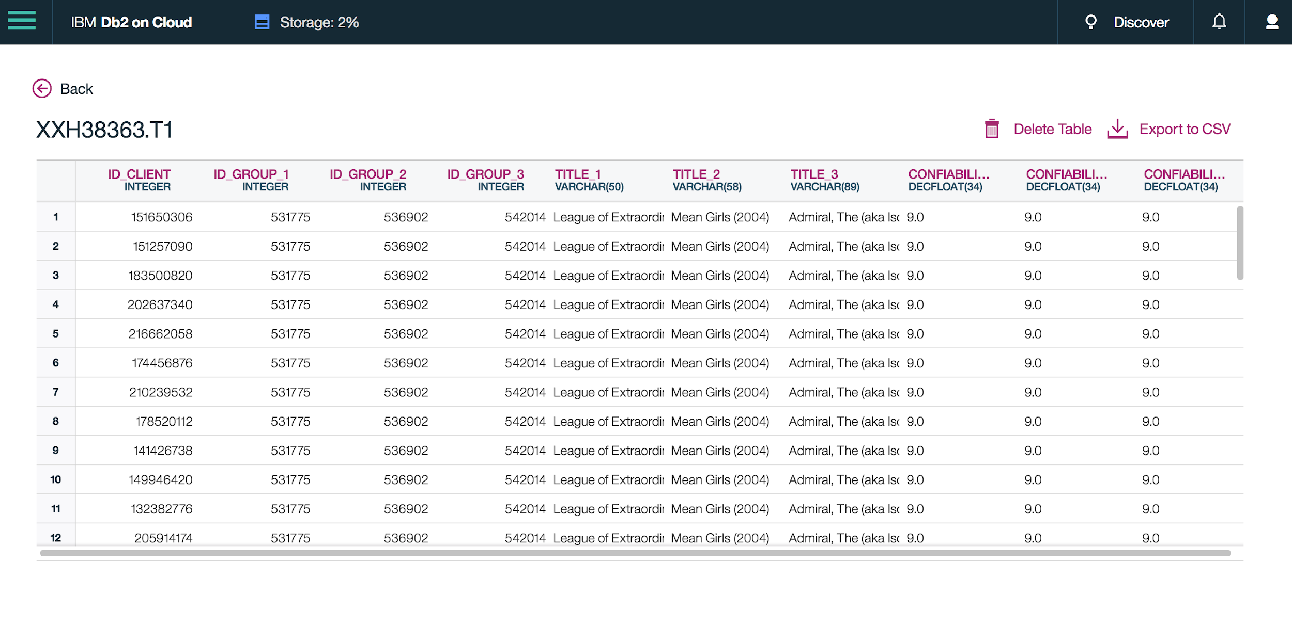
3_FILM DATABASE STRUCTURE

Slide 20
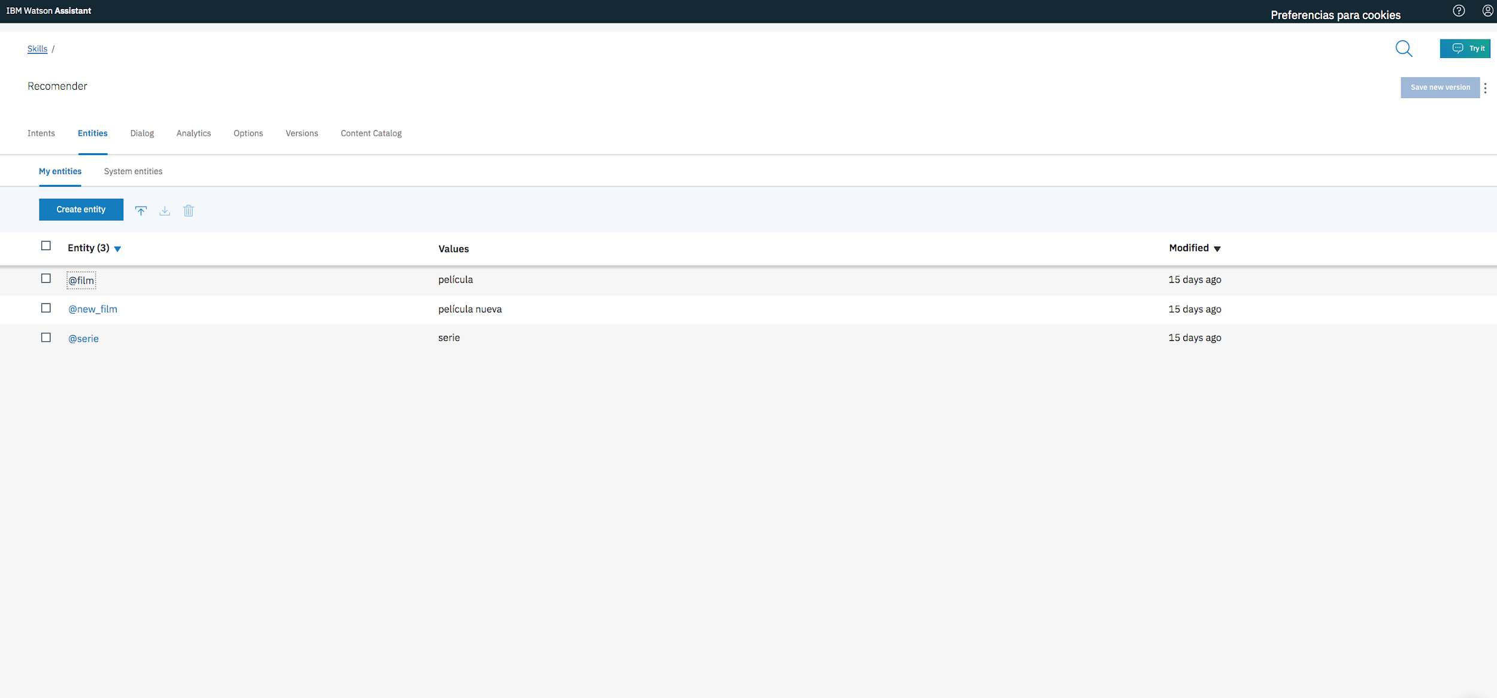
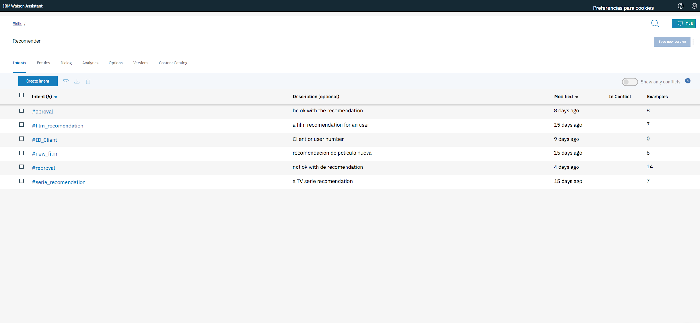
3_INTENTS & ENTITIES

Slide 21
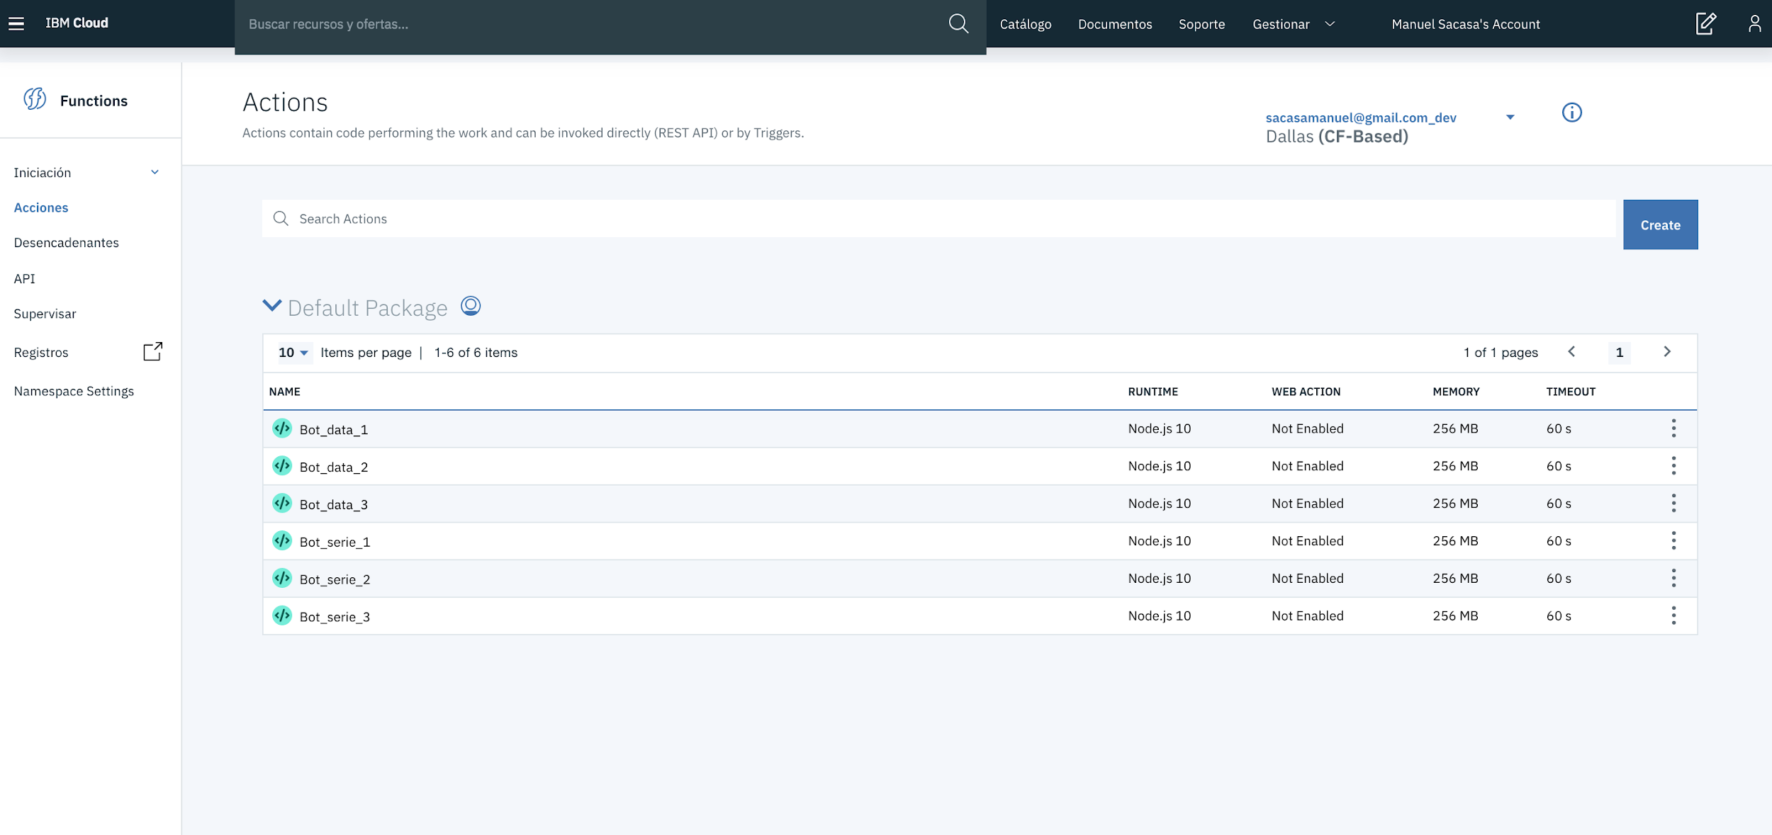
3_QUERIES

Slide 22
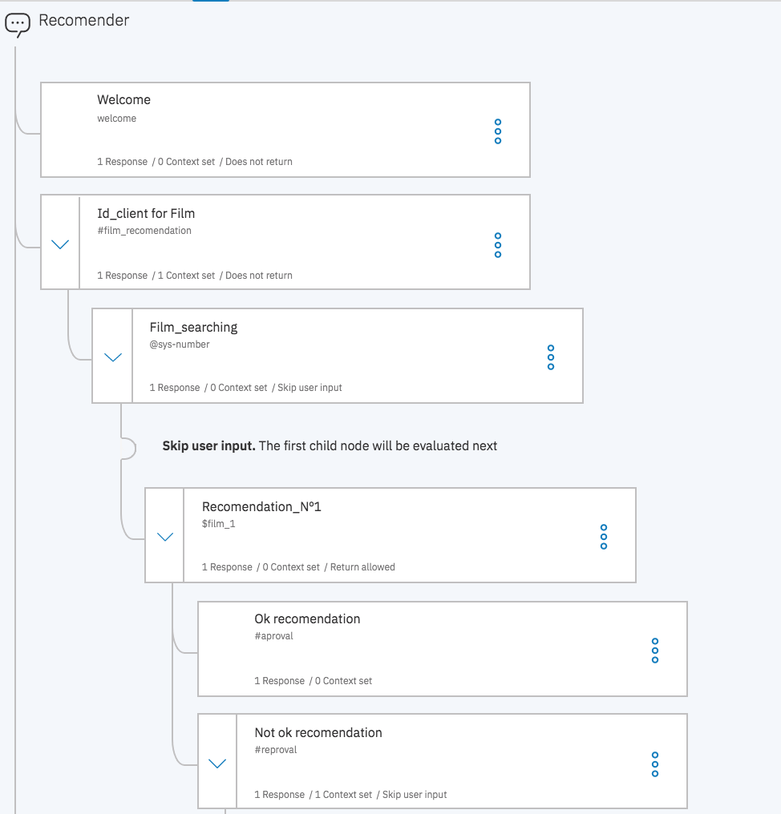
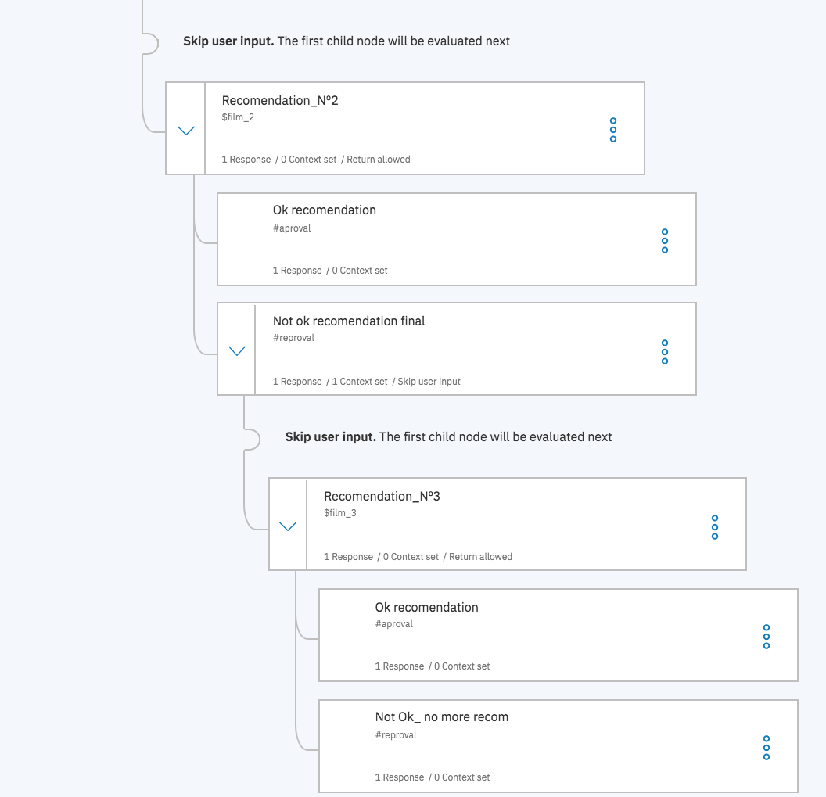
3_DIALOGUES
Real Film recommendation dialogue zoom in
Zoom from welcome dialogue to OK/Not OK recommendation dialogue. Each dialogue is link with a context variable, entity or intent to select the next path. In this way the chatbot reacts to recommend, recommend again, apologize for not understand, and close de conversation

Slide 23
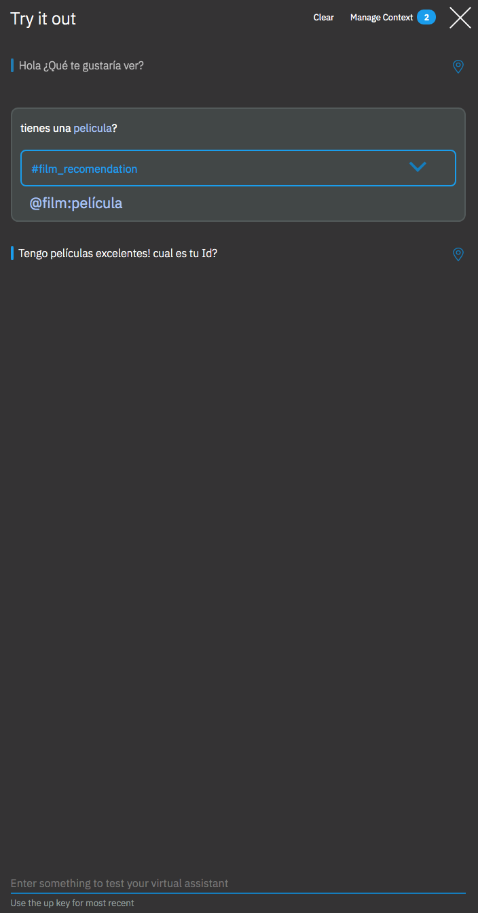
3_CHATBOT
Image _ Watson assistant testing interface
Welcome
Film
Recommendation_1
Approval
Recommendation_2
Approval
Reproval
Recommendation_3
Approval
Reproval
R_1
Approval
Serie
Reproval
R_2
Approval
Reproval
R_3
Approval
Not understand
Reproval
Reproval

Slide 24
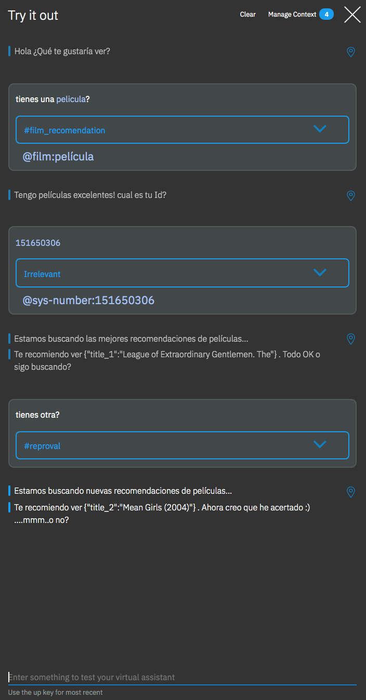
3_CHATBOT
Image _ Watson assistant testing interface
Welcome
Film
Recommendation_1
Approval
Recommendation_2
Approval
Reproval
Recommendation_3
Approval
Reproval
R_1
Approval
Serie
Reproval
R_2
Approval
Reproval
R_3
Approval
Not understand
Reproval
Reproval

Slide 25
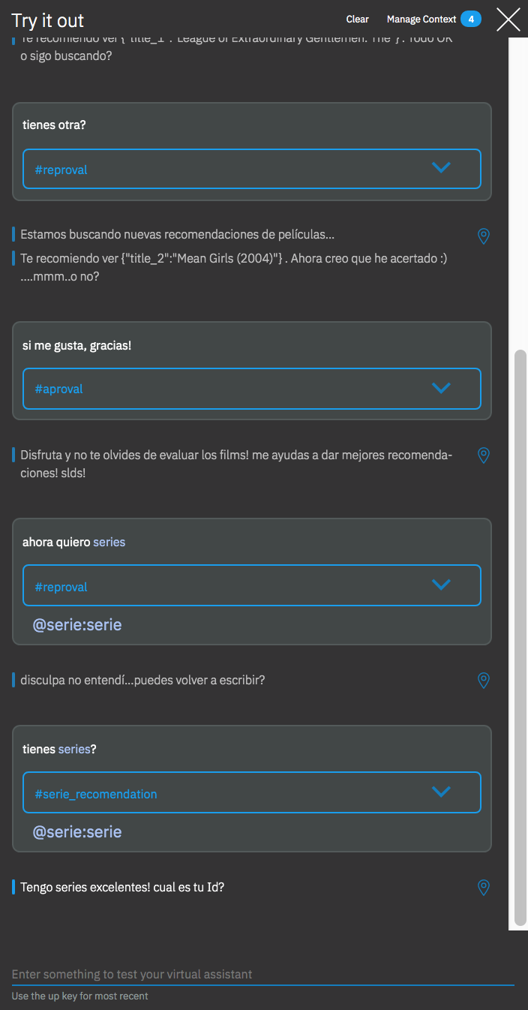
3_CHATBOT
Image _ Watson assistant testing interface
Welcome
Film
Recommendation_1
Approval
Recommendation_2
Approval
Reproval
Recommendation_3
Approval
Reproval
R_1
Approval
Serie
Reproval
R_2
Approval
Reproval
R_3
Approval
Not understand
Reproval
Reproval

Slide 26
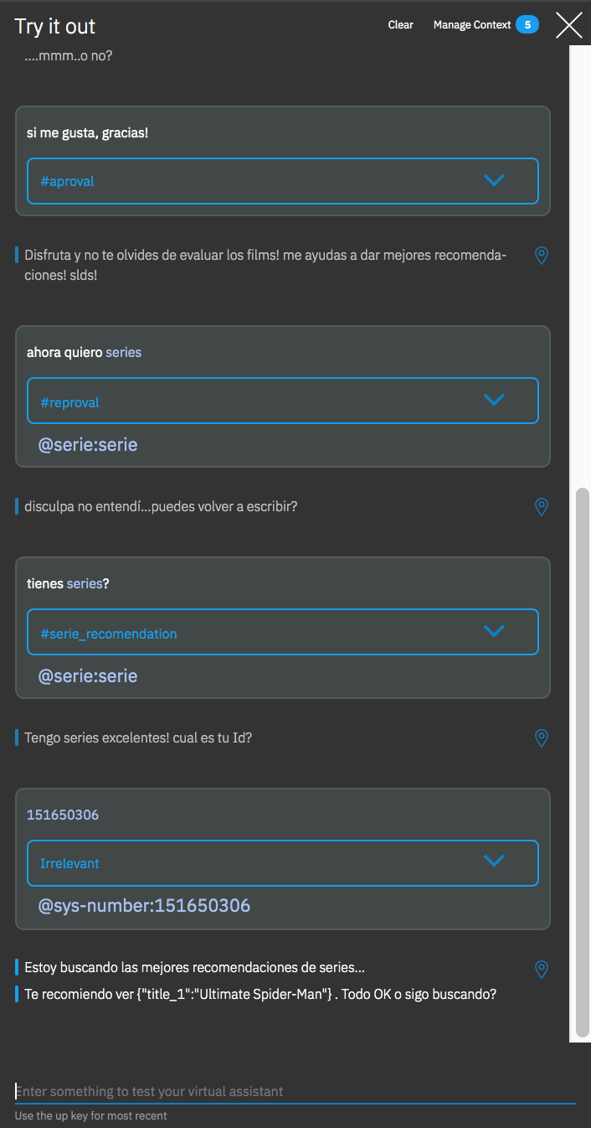
3_CHATBOT
Image _ Watson assistant testing interface
Welcome
Film
Recommendation_1
Approval
Recommendation_2
Approval
Reproval
Recommendation_3
Approval
Reproval
R_1
Approval
Serie
Reproval
R_2
Approval
Reproval
R_3
Approval
Not understand
Reproval
Reproval

Slide 27
UDD - Universidad del Desarrollo_MDS - Master in Data Science
PRODUCT RECOMMENDER
CHATBOT
Students
Rovai, Marcelo_ Sacasa, Manuel
Professors
Reinoso, Pablo_ Seguel, Rodrigo
May, 2019

